Slide 1
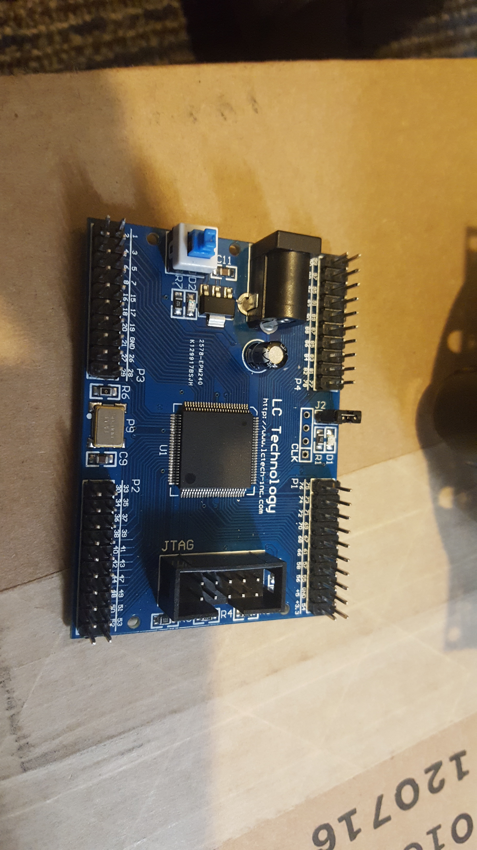
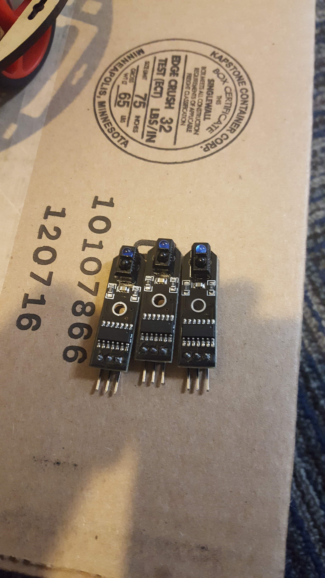
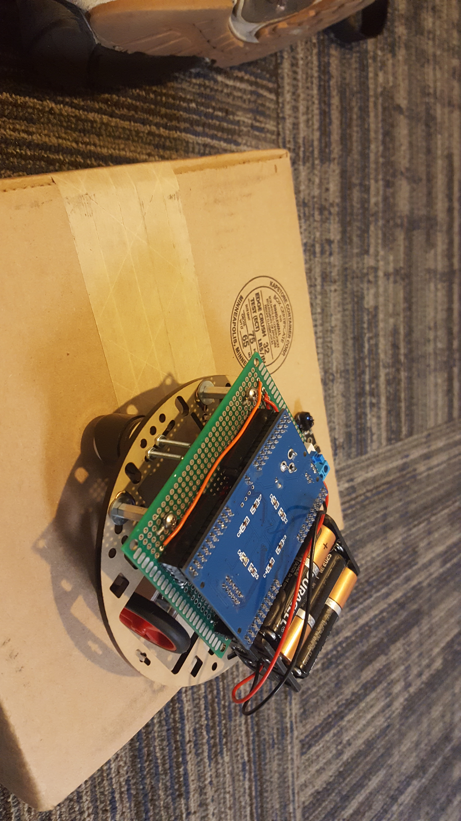
Team Samsung
Alamin Ahmed
Luis Robles
Steven Ventura
Vinh Vu
Daniel Lopez

Slide 2
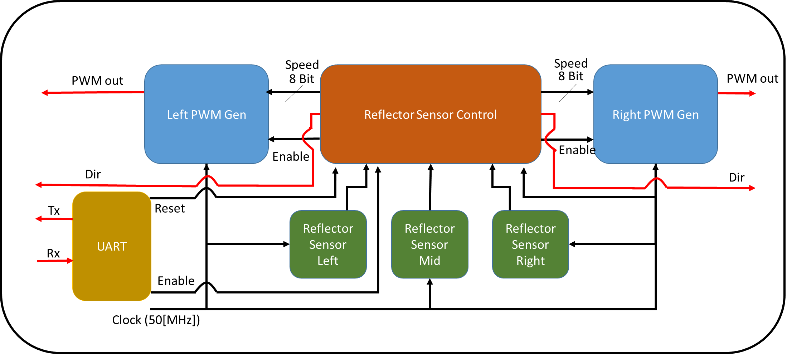
We will be building a line follow robot with a FPGA board. We will be using Verilog to write our code and a device level coding to implement our program to the board. We will be using following state diagram:

Slide 3
Black Line
Sensor Output is Low (0[V])
White Space
Sensor Output is High (3.3[V])
Sensors
SL
SM
SR

Slide 4
ABB | Name
SL | Sensor Left
SM | Sensor Middle
SR | Sensor Right
ABB | Name
RM | Right Motor
LM | Left Motor
SL | SM | SR | State of the Robot | What the Robot should Do
H | H | H | End of the line | Stop
H | H | L | Went to far to the Left | RM = OFF LM = ON
H | L | H | Running in the Middle | RM = ON LM = ON
H | L | L | Drifting to the Left | RM = 50% LM = ON
L | H | H | Went to far to the Right | RM = OFF LM = ON
L | H | L | ERROR (Ignore) | RM = ON LM = ON
L | L | H | Drifting to the Right | RM = ON LM = 50%
L | L | L | AT a “T” intersection | RM = ON LM = ON

Slide 5
Name | Tasks | Check List
Alamin Ahmed | Constructing the Robot Line Follow Module
Daniel Lopez | Line Follow Module UART Module
Steven Ventura | Line Follow Module UART Module
Vinh Vu | UART Module Test Bench
Luis Robles | PWM Generator Module Test Bench

Slide 6
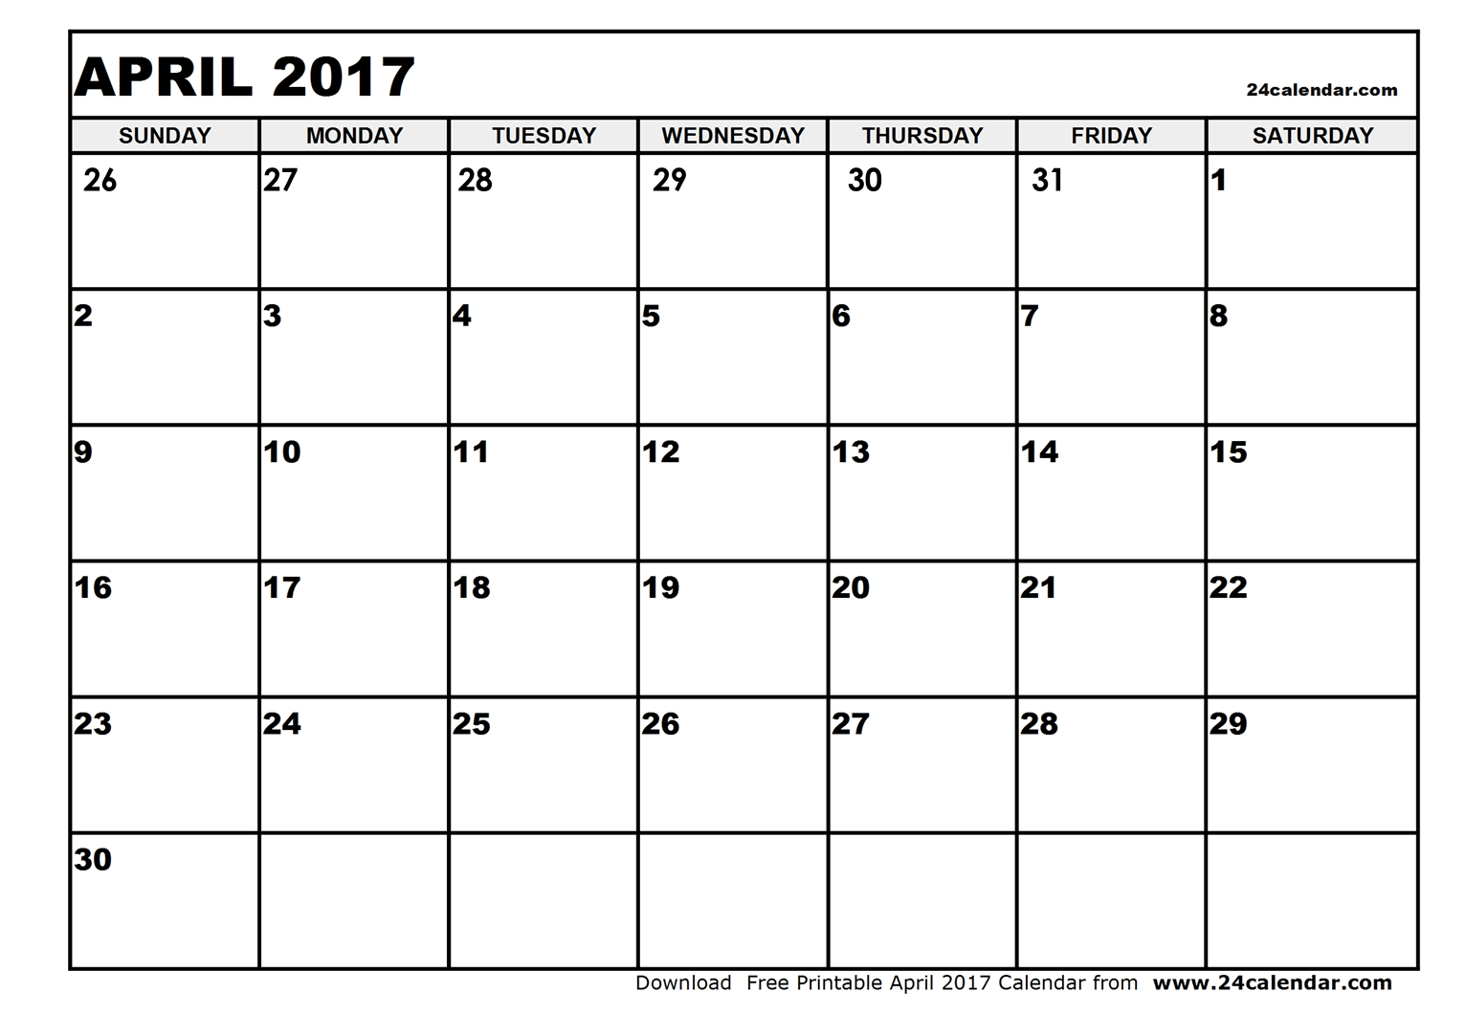

Time Line
Name | Tasks
Alamin Ahmed
Daniel Lopez
Steven Ventura
Vinh Vu
Luis Robles
Line Follow
Robot Co.
Line Follow
Due
Line Follow
Line Follow
UART
Line Follow
UART
Due
UART
UART
Line Follow
UART
Test Bench
Test Bench
Due
UART
Test Bench
Prepare For Final Report
Final Project
Due
PWM
Test Bench

Slide 7
DEMO

